Slide 1
Integrating Technical Analysis with Predictive Models
Introduction & Objective of the Research
Research Problem
Methodology
System Design & Implementations
Deliverables & Outcomes
Ashesh B. Bajracharya
Nagarjuna College Of IT
CSIT, 5th Sem
Summary of the Research
References and Q&A.

Slide 2
01
Introduction & Objective of Research

Slide 3
Introduction
02
This research seeks to evaluate the comprehensive analysis of a trading strategy based on the principles of support and resistance, utilizing historical stock data to backtest the strategy’s effectiveness.
In the context of trading, Support and resistance are the fundamental concept of technical analysis to anticipate potential reversal points in the price movements.
The research involves collection of data sets of BANKING Index of NEPSE from mid 2019 to present, preprocessing data, identifying support and resistance levels using specific candlestick patterns, and backtesting the strategy with simulated trades to assess performance metrics such as profit, loss, and win rate.
Machine learning models, including Long Short-Term Memory (LSTM) and Auto-Regressive Integrated Moving Average (ARIMA), are utilized to forecast future stock prices and enhance the strategy’s predictive accuracy.

Slide 4
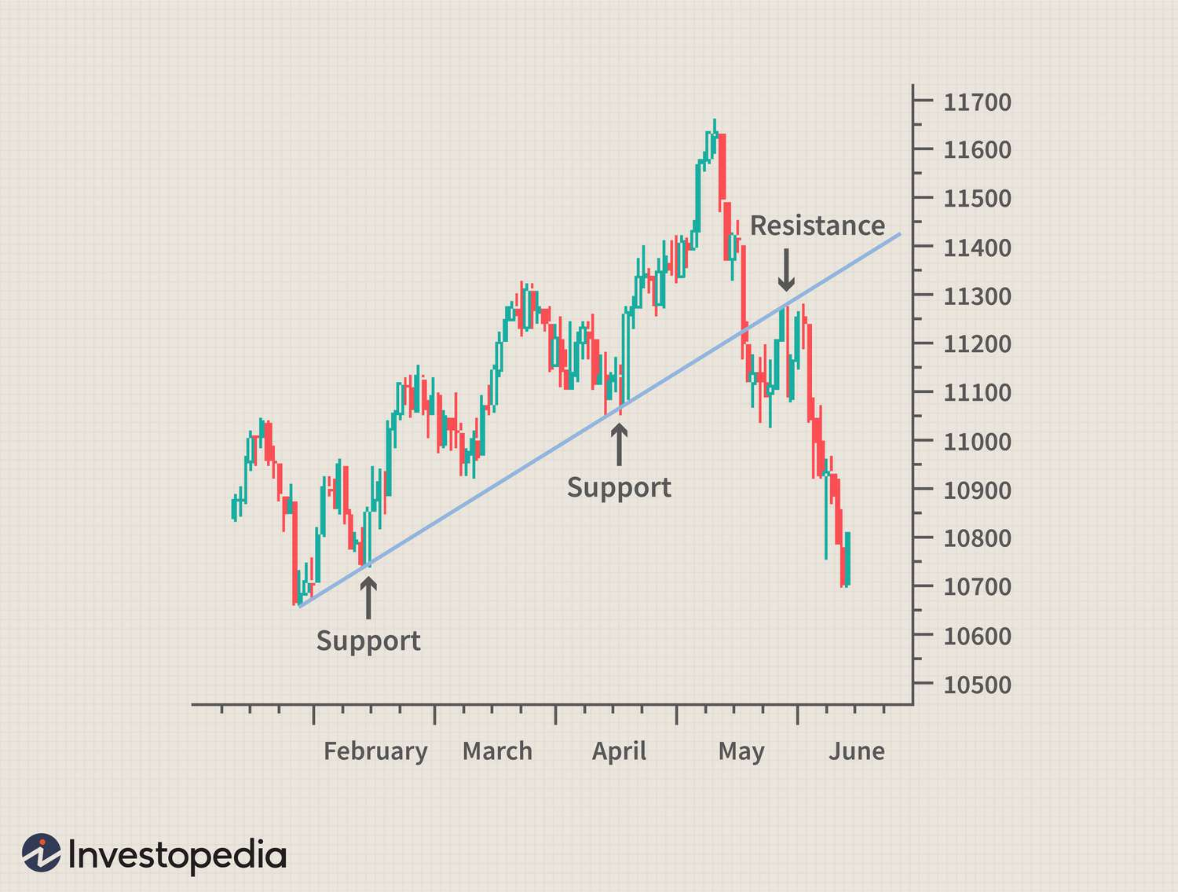
03

Slide 5
Objectives of the Research
04
To backtest the support and resistance trading strategy by analyzing historical stock data.
To predict future stock movements by employing advanced predictive models.

Slide 6
05
Research Problem

Slide 7
Research Problem
06
Identification of Effective Trading Signals: Determine how well the strategy identifies support and resistance levels using specific candlestick patterns.
Assessing Historical Performance: Evaluate the profitability and risk management of the strategy through backtesting with historical stock data.
Predicting Future Price Movements: Utilize advanced predictive models, including LSTM networks and ARIMA model to forecast future price movements.
Visualizing Outcomes: Assess how effectively the strategy’s outcomes, including identified levels, generated signals, predictive forecasts, and backtesting results are visualized.

Slide 8
07
Methodology

Slide 9
Waterfall Model
08
Data Collection
Data Preprocessing
Strategy Implementation
Backtesting Framework
Predictive Analysis Model
Deployment of Model

Slide 10
09
System Design & Implementations

Slide 11
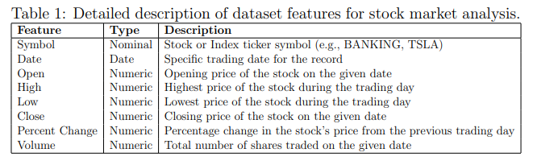
System Design & Implementations
10
Data Collection: This phase involves acquiring historical stock data from various reliable sources, including financial databases. The collected data encompasses features such as Symbol, Date, Open, High, Low, Close, Percent Change, and Volume.

Slide 12
System Design & Implementations
11
Data Preprocessing & EDA: we undertook several critical steps to ensure the quality and usability of
the dataset:
Handling Missing Values.
Outlier Detection & Handling.
Feature Engineering.
Saving the Filtered Dataset.
Data Transformation.

Slide 13
System Design & Implementations
12
Strategy Implementation: In this section, we outline the process of implementing the trading strategy based on support and resistance levels, and how buy and sell signals were generated.
Generating Support and Resistance Levels:
Support levels were identified by analyzing historical price data to find points where the stock price consistently found a lower bound.
The support function is designed to detect potential support levels by analyzing the low prices of candlesticks within a specific window of time.
Resistance levels were similarly identified by finding points where the stock price encountered a consistent upper bound, indicating strong selling pressure.
The resistance function identifies potential resistance levels by analyzing the high prices of candlesticks.

Slide 14
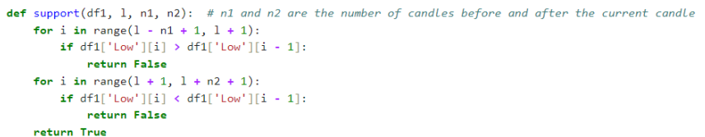
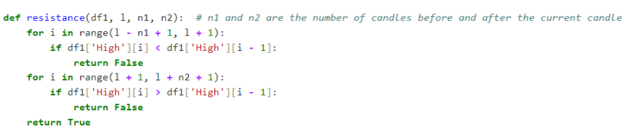
Support & Resistance Functions
13

Slide 15
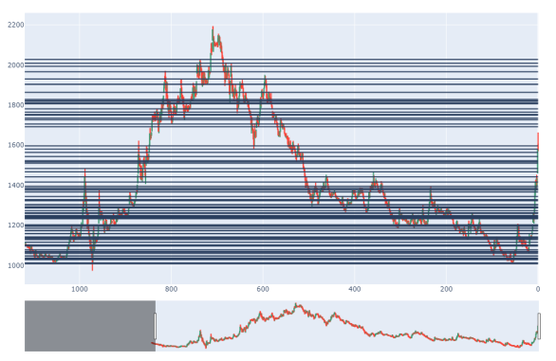
Plotting Support and Resistance Lines
14

Slide 16
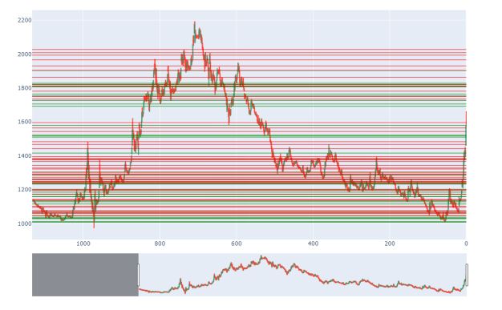
Visualization of Support and Resistance Levels with Color-Coded Lines
15

Slide 17
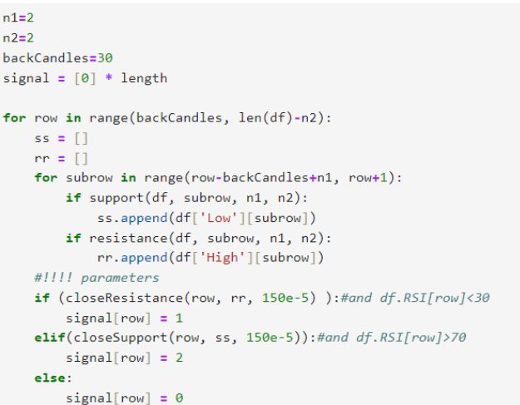
Generating Buy and Sell Signals
16
If the current price is close to any of the identified support levels (ss), a buy signal is generated. This is determined by the closeSupport function.
If the current price is close to any of the identified resistance levels (rr), a sell signal is generated. This is determined by the closeResistance function

Slide 18
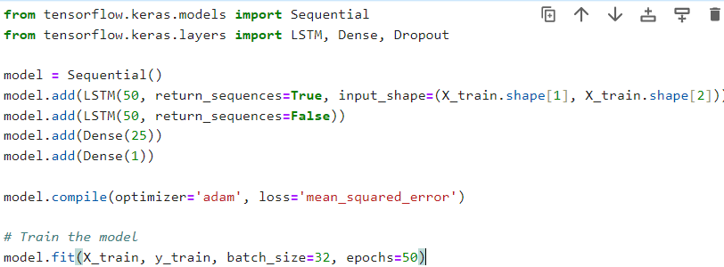
Machine Learning Model Implementations
17
LSTM Model : Long Short-Term Memory (LSTM) networks are a type of recurrent neural network (RNN) designed to handle sequential data.

Slide 19
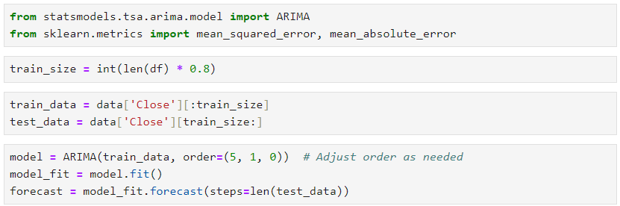
Machine Learning Model Implementations
18
The ARIMA (Auto Regressive Integrated Moving Average) model is a popular statistical approach for analyzing and forecasting time series data.

Slide 20
19
Deliverables & Outcomes

Slide 21
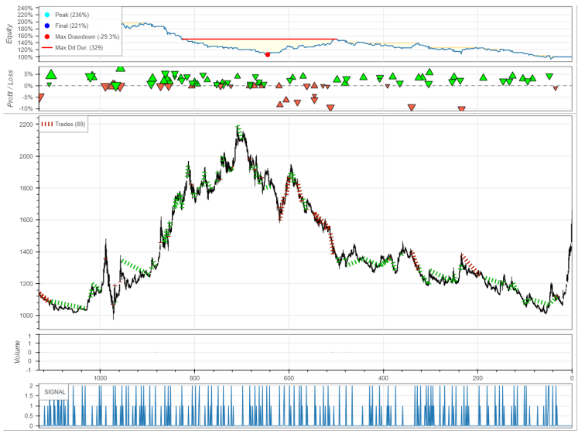
Buy & Sell Signals Plot
20

Slide 22
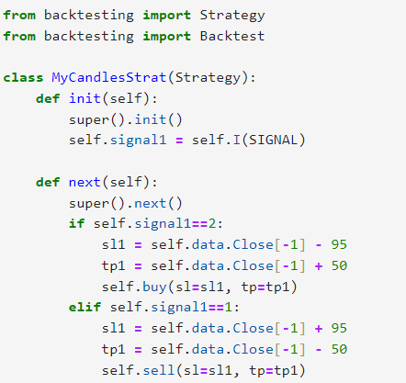

Backtesting Strategy
21
The ’Backtest’ class is used to run the strategy on historical data, providing performance metrics to evaluate its effectiveness.

Slide 23
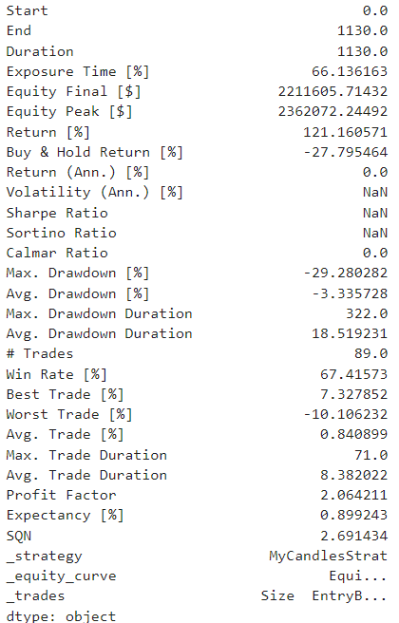
Backtesting Outcome
22

Slide 24
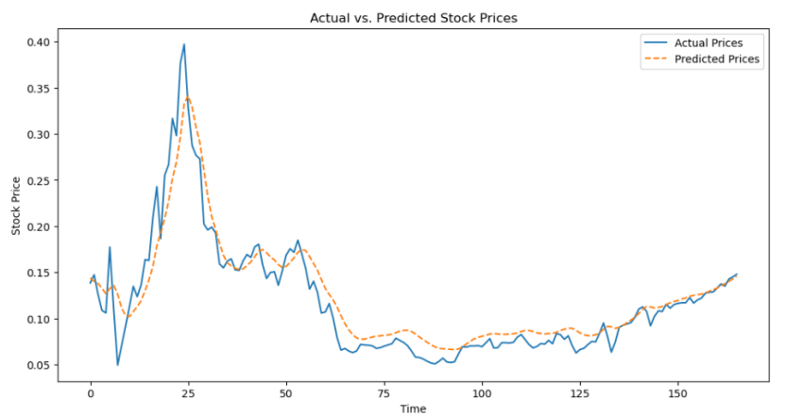
Actual vs Predicted For LSTM Model
23

Slide 25
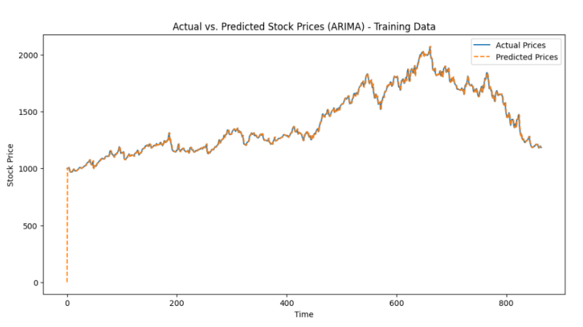
Actual vs Predicted For ARIMA Model
24

Slide 26
25
Research Timeline Schedule & Other Diagrams

Slide 27
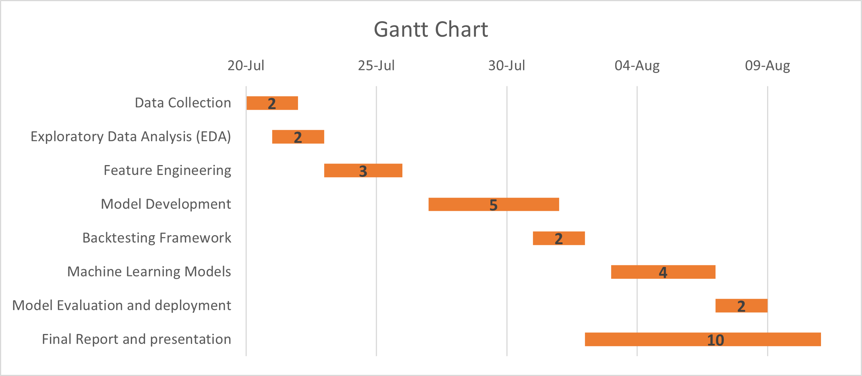
Gantt Chart
26

Slide 28
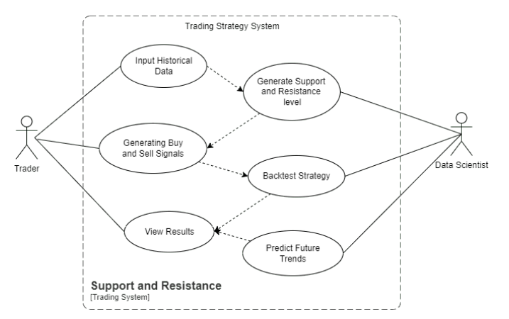
Use Case Diagram
27

Slide 29
28
Summary & Conclusion

Slide 30
Summary
29
Effectiveness of Support and Resistance Strategy: The research demonstrates that the support and resistance trading strategy was effective, as evidenced by favorable results from backtesting.
Integration with Other Strategies: The strategy's performance can be further enhanced by integrating it with additional indicators such as momentum, moving averages, and RSI.
Future Utility: The identified support and resistance levels have potential future applications, as they can effectively generate buy and sell signals.
Model Comparison: Between LSTM and ARIMA models, LSTM proved to be superior due to its lower error rates, making it the preferred choice for more effective backtesting.
Optimized Backtesting: Leveraging the LSTM model for backtesting provided more accurate and reliable results, improving the overall effectiveness of the trading strategy.

Slide 31
Conclusion
30
Profitability of Strategy: The support and resistance trading strategy yields significant profits, as demonstrated by backtesting results.
Superiority of LSTM: Between LSTM and ARIMA, LSTM showed lower error rates and superior accuracy, making it the preferred model for future stock predictions.
Fusion of Backtesting and Prediction: Combining backtested results with LSTM-based future predictions allows traders to identify future support and resistance levels effectively.
Enhanced Strategy Effectiveness: This fusion of backtesting and predictive analysis strengthens the strategy, making it a powerful and resilient tool for trading.

Slide 32
References
1] H. Manh, Duong, B. Siliverstovs, Manh, and H. Duong, “The stock market and investment,” Jul. 2006.
[2] K. Chung and A. Bellotti, Evidence and behaviour of support and resistance levels in financial time series, Jan. 2021.
[3] S. Tabot, “Investigating the merits of support and resistance strategy: Evidence from international financial markets,” Journal of economic and social development, vol. 10, pp. 75–80, Sep. 2023.
[4] E. O. Yıldırım, M. U¸car, and A. M. Ozbayo˘glu, “Evolutionary ¨ optimized stock support-resistance line detection for algorithmic trading systems,” in 2019 1st International Informatics and Software Engineering Conference (UBMYK), 2019, pp. 1–6. doi: 10.1109/UBMYK48245.2019.8965471.

